Slide 1
Nursing Faculty
Online Orientation
Affiliated Schools of Nursing
Nursing Education and Research Department
Beaumont Hospital, Troy

Slide 2
Welcome to Beaumont Hospital, Troy
Welcome to Beaumont. We hope our affiliation will be a positive one and provide the needed clinical learning experience for your students.
We make every attempt to place you and your students in the atmosphere most suitable for the level of learning you request, however there may be times that particular units requested are unavailable. Occasionally, the number of clinical placements and their learning requirements necessitate that we have more than one group of students rotating through in a given week. If this impedes your clinical experience please contact us and we will attempt to adjust your placement.

Slide 3
Alliance for Clinical Experience (ACE)
Michigan educational institutions and clinical facilities have joined with the Michigan Health Council to improve placing students’ for clinical experiences. The program is called Alliance for Clinical Experience (ACE). Through ACE you have completed some training modules that all universities and hospitals have in common, however, there is additional training that must be completed specifically for Beaumont prior to your first day of clinical.
The Beaumont specific training modules are in your personal learning account. The Compliance, Confidentiality and Orientation modules are done yearly. The Electronic Medical Record (EMR) training modules are done only once. Keep your user name and password as you will use this account if you return in future semesters.

Slide 4
Covid-19 Instructions for Faculty & Nursing Students
Please enter hospital through the Parking Deck Main entrance. This entrance will be open from 5:30 a.m. to 9 p.m. The Sterling Heights parking lot/pedestrian bridge will be available only to employees as Badge access will be required to enter.
Each day you are entering the hospital, you are required to complete the “COVID-19 Assessment for non-Beaumont employed entrants” – see slides 5-7 for full details how to access online assessment process.
Please wear your Faculty/ Student ID, which must be visible while on site. Pick up your Beaumont Faculty ID the first day you are here, or as soon as possible after receiving this information.
You must wear a surgical mask that will be provided for you upon entry. It must be worn at all times while on site. Masks brought from home cannot be used. N95 masks will not be provided. Students/Faculty will not be allowed to care for COVID positive patients.
Break rooms are for staff only – we cannot share them at this time due to “social distancing”. Please try to maintain social distancing when possible on the unit.
Hand washing and disinfecting protocols must be followed.
Conference rooms can be requested for pre & post meetings, but if these can be done off-site, it would be preferred, as we cannot guarantee a room that will provide social distancing or availability.
Lockers are not available for personal items (please keep personal items as much as possible at home or locked in the trunk of your vehicle).

Slide 5
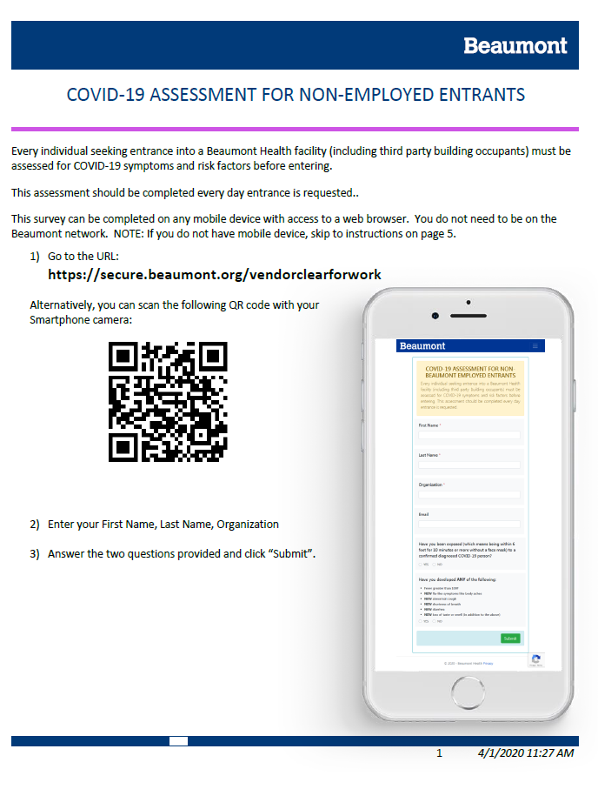
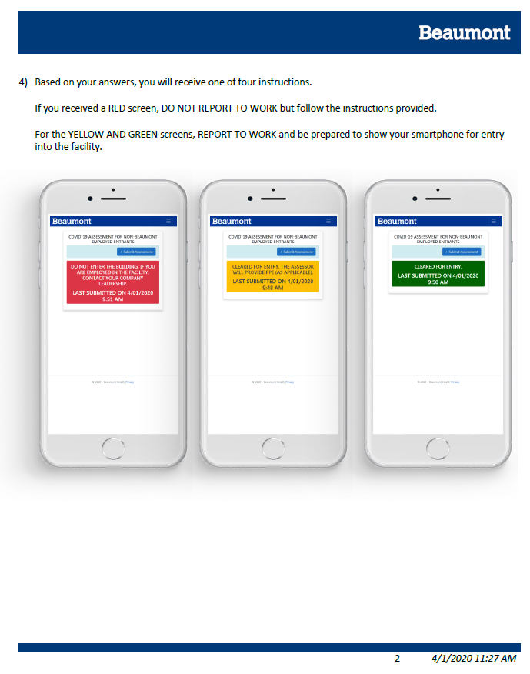
COVID-19 ASSESSMENT FOR NON-EMPLOYED ENTRANTS

Slide 6
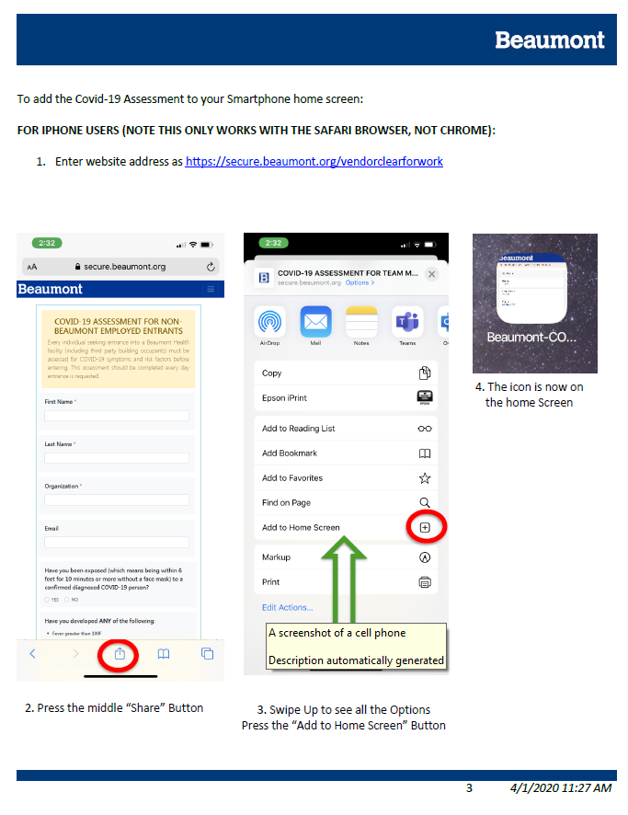
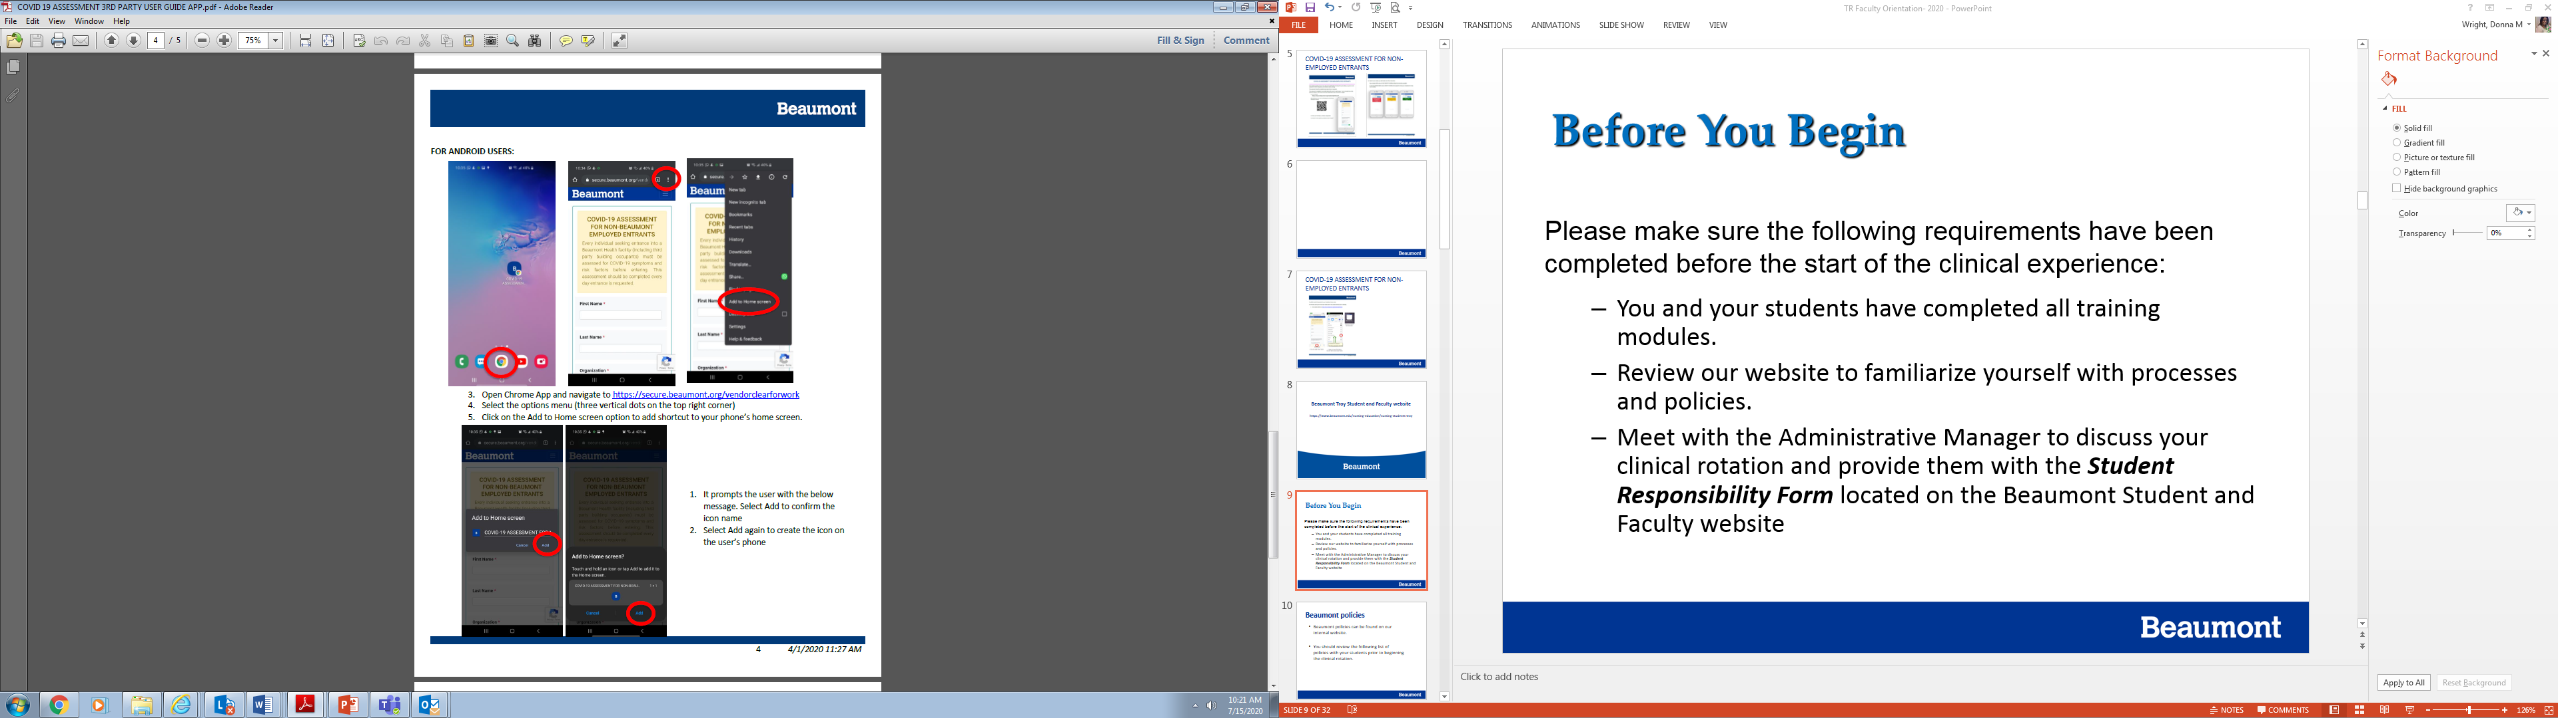
COVID-19 ASSESSMENT FOR NON-EMPLOYED ENTRANTS

Slide 7
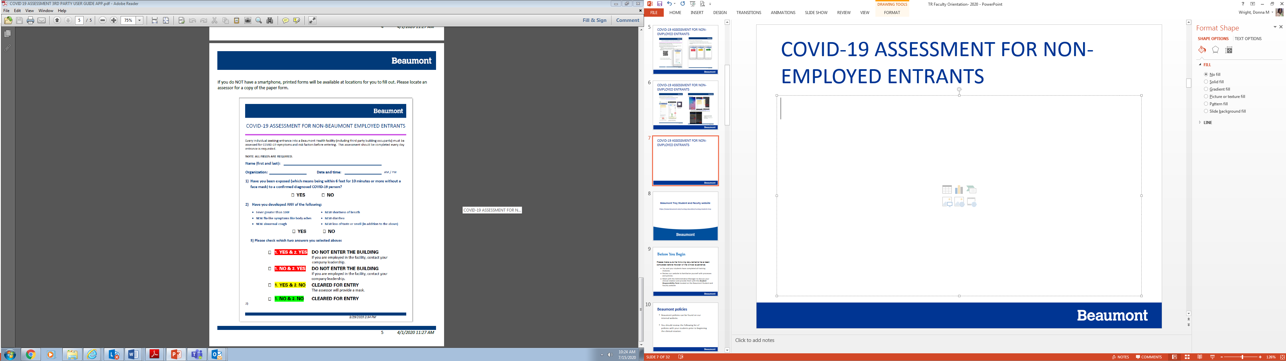
COVID-19 ASSESSMENT FOR NON-EMPLOYED ENTRANTS

Slide 8
Beaumont Troy Student and Faculty website https://www.beaumont.edu/nursing-education/nursing-students-troy

Slide 9
Before You Begin
Please make sure the following requirements have been completed before the start of the clinical experience:
  You and your students have completed all training modules.
  Review our website to familiarize yourself with processes and policies.
  Meet with the Administrative Manager to discuss your clinical rotation and provide them with the Student Responsibility Form located on the Beaumont Student and Faculty website

Slide 10
Beaumont policies
Beaumont policies can be found on our internal website.
You should review the following list of policies with your students prior to beginning the clinical rotation.

Slide 11
Beaumont policies
Beaumont is in the process of merging and updating various policies.
As this is being done, policies are being moved to our corporate web page.
To ensure you are accessing the correct policy version, we have created instructions on accessing policies which is posted on our web page. http://www.beaumont.edu/nursing-education/nursing-students-troy
Please go there, print off the instructions, and then look up the policies listed on the following slides.

Slide 12
Beaumont policies Cont’d
Urinary Catheter-Indwelling Policy, Adult Patients #768
Nursing Student Clinical Placement/Responsibilities #845
Patient Identification #322
High Alert Medications #1004
Fall Risk Assessment, Prevention & Interventions #500
Adult Corporate and Site Specific IV Push Lists #1017.1
Corporate Continuous Infusion List #1017.2
Precautions to Prevent Transmission of Disease #2.20
Precautions for Specific Infectious Diseases #2.30
Restraint Policy: Guidelines for the Use of Restraint #240

Slide 13
Hospital CPR
In the event a patient requires CPR and the student is the first responder they should push the CPR button on the wall and begin chest compressions per AHA BLS guidelines until hospital staff arrives.
Students may not actively participate in a CPR but can observe as long as they are not in the way of the code team.
Ensure your students know their patient’s CPR status and the location of the CPR button in each room.

Slide 14
Infectious Disease
Review the Infection Control PowerPoint on the website with your students. If you would like to arrange an in-service from our Epidemiology department, please call (248-96)4-7144.
As faculty and students have not been fit tested for the N95, they are not allowed to care for patients requiring the staff use of the N95 mask or alternate Max Air device.

Slide 16
Charting
Beaumont uses an electronic medical record (EMR) system named EPIC. In EPIC, when students log into the system, they must choose their faculty or preceptor; which will then be authorized as their co-signer.
A tip sheet on logging in and cosigning is on our website.
For any paper recording, students must sign first and last name, SN and school to all notes (i.e. Mary Doe, SN, OCC).
If you have difficulty logging in DO NOT CONTACT THE UNIT MANAGER OR THE I.T. HelpDesk; contact Nursing Education and Research at (248) 551-6420.

Slide 17
Medications
Only faculty will have an ID number and a password to access the Pyxis medication system. Students may administer medications under the supervision of their faculty.
Both faculty and student must initial and sign on the Medication Administration Record or e-MAR.
To access Pyxis you will use the same instructor ID# and password you use for EPIC. After that you should be prompted to register your fingerprint.

Slide 18
Patient Family Centered Care
Our patients are the center of all we do at Beaumont
Faculty is required to introduce themselves and their students to patients, and ensure the patient agrees to have a student work with them
Reassure the patient that your student is under your and their nurse’s supervision at all times
If the patient does not want a student involved in their care, please change the patient assignment to accommodate their wishes

Slide 19
Training
Through ACEMAPP you completed training modules that all universities and hospitals have in common, however, there is additional training that must be completed specifically for Beaumont prior to your first day of clinical.

Slide 20
Training
Beaumont regulatory and nursing modules are housed in our system called HealthStream and are required yearly.
Beaumont Electronic Medical Record (EMR) training modules previously housed in our system called IT Training Center are being moved to HealthStream on January 1, 2020.

Slide 21
Beaumont Systems
The university initiates the process in ACEMAPP to send your information to Beaumont.
Within a couple days, you’ll receive an email from HealthStream stating an account has been created for you and lists the modules to complete. It includes the following disclaimer;
  Please note: Students and Faculty no action is required on your part at this time. You will be receiving further instructions from your clinical program approximately one week prior to the start of your rotation. The instructions will include the due date for completion based on your clinical rotation; which are not the dates next to the courses below.

Slide 22
Beaumont Systems
As stated in the Disclaimer, you’ll receive an email from NursingStudents@Beaumont.org with your ID# and instructions on creating a password through a web link approximately one week prior to the start of your rotation.

Slide 23
Preceptor Placement
Beaumont obtains preceptors with degree and experience levels in areas requested by the university
The university matches students with our preceptors
Once students are assigned and the ACEMAPP roster is sent to us, we send out the training information
Once training is completed, we send an email to the Administrative Manager, RN preceptor, Faculty and Student which contains contact information so that the student can arrange their hours

Slide 24
Faculty Responsibilities
Most faculty visit the campus to meet with their student and preceptor, therefore, faculty are required to complete regulatory and nursing modules.
When on hospital campus wear university identification badges.

Slide 25
Parking
Students/Faculty MUST park across the street in the Beaumont Medical Center, Sterling Heights parking lot located on the east side of Dequindre Road (opposite the hospital). The bridge should be utilized to get to the hospital. The bridge entrance is on the second floor of the Beaumont Medical Center.
Students/Faculty are not permitted to park in designated “Patient & Visitor Parking Only” areas (i.e. Patient/Visitor Lots or Decks). Violators will be booted or towed, at their own expense as well as a $100 fine.

Slide 26
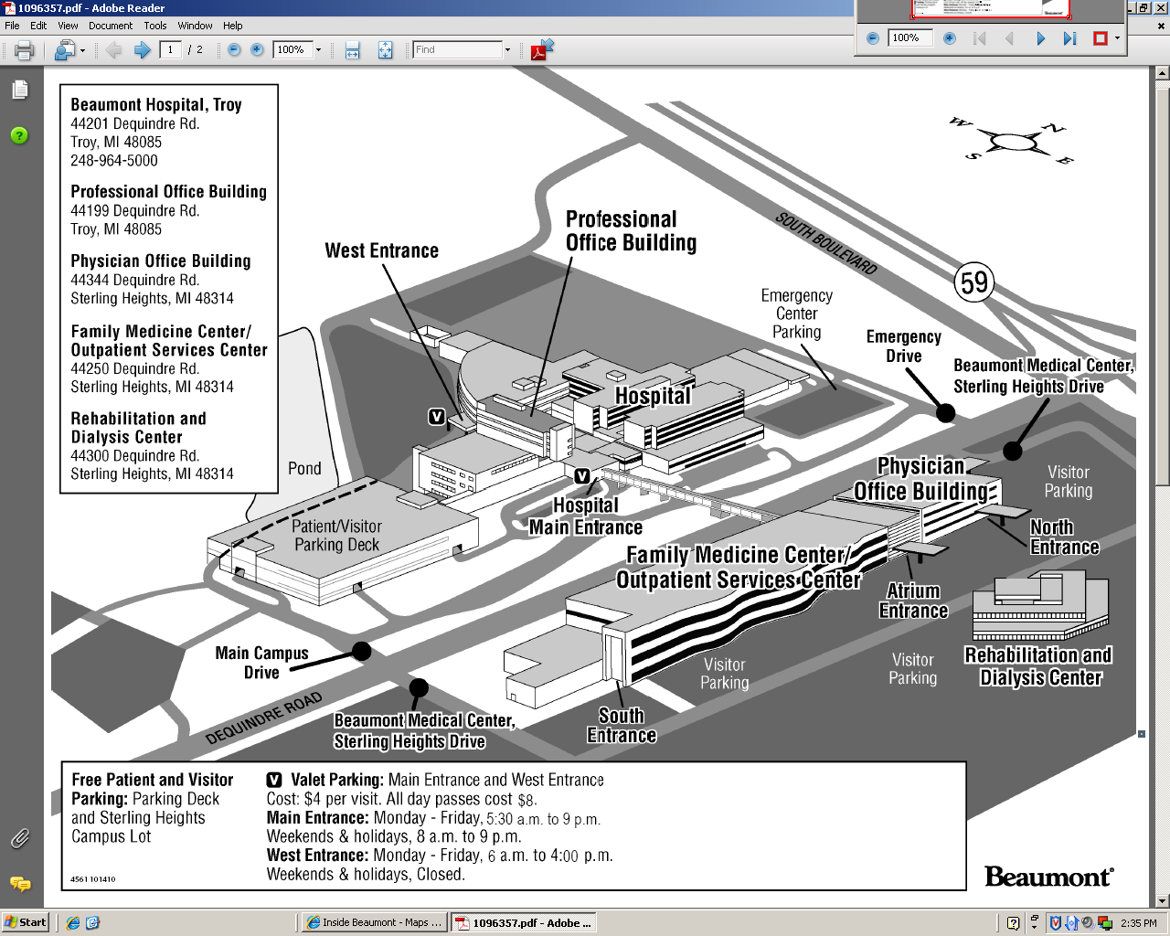
Campus Map

Slide 27
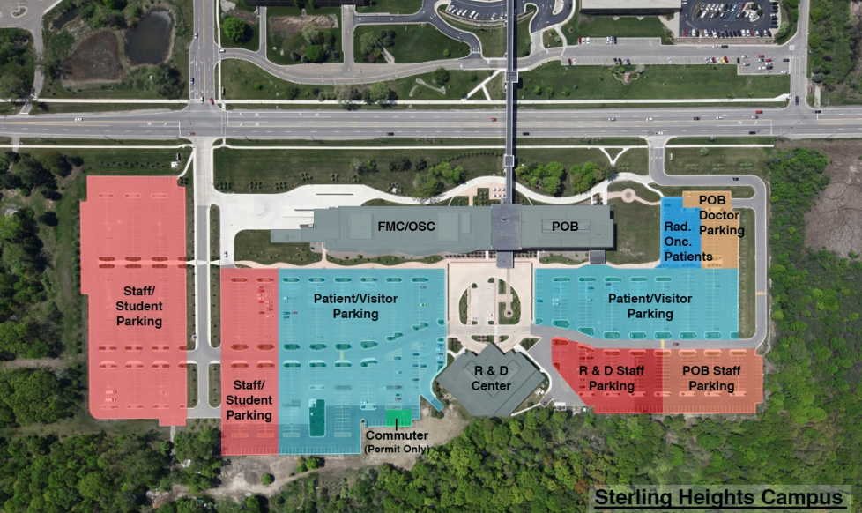
Aerial View of Student Parking
W
S N
E
Bridge
Dequindre Road

Slide 28
Security Access - Badges
All faculty must wear Beaumont identification. Badges are issued by the Security Department located on the ground floor in area F (near the Learning Center). Hours are Monday - Friday, 7 a.m. - 3:30 p.m., closed 12 p.m. - 1 p.m. for lunch.
Faculty may wear business casual with a lab coat or their school uniform.
Students are to wear their school uniforms (Do Not wear Hoodies) and school ID badges.

Slide 29
Classroom Reservation
Request for rooms should be sent to Krystal.Garbarino@beaumont.org.
Please keep in mind conference rooms are very limited and although we will try to accommodate your request it may not be possible.

Slide 30
Process
Our patients are the center of all we do at Beaumont
Therefore as general practice for Faculty that bring students to campus for unit-based rotations we ask that you introduce your students to their assigned patients, and ensure that the patients agree to have a student work with them
Reassuring the patients that your student is under your and their nurse’s supervision at all times
If the patient does not want a student involved in their care, please change the patient assignment to accommodate their wishes

Slide 31
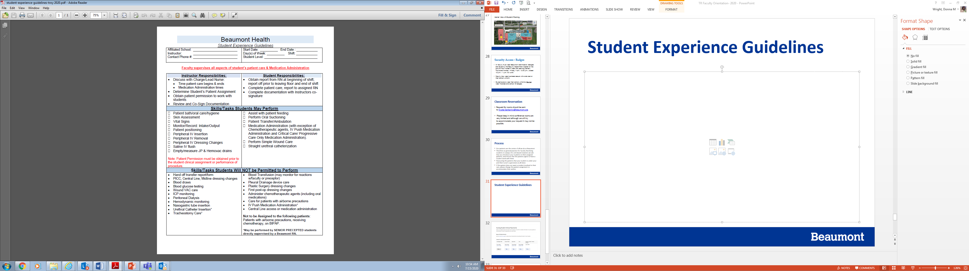
Student Experience Guidelines

Slide 32
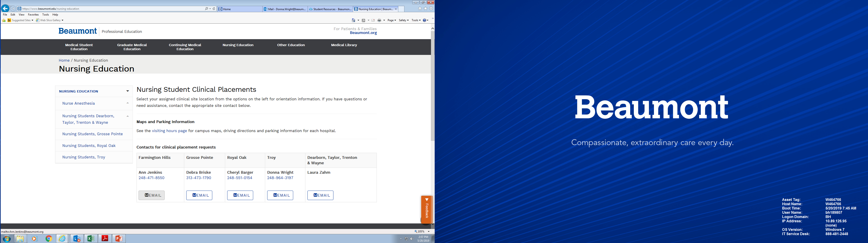

Slide 33
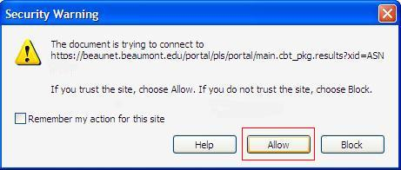
Questions?
Please contact the Nursing Education & Research Department at (248) 964-8140 if you need any assistance. Our office is located in the Moceri Learning Center, lower level area F.
CLICK THE DONE BUTTON
If you receive this message, please click the Allow button

