Slide 1
Dyspnea and Respiratory Failure
OUWB School of Medicine
Beaumont Health System
Department of Emergency Medicine

Slide 2
Overview
Acute Asthma Exacerbation
COPD
Pneumonia
CHF
Respiratory Failure
Drug OD
CNS Causes
Airway Obstruction
Angioedema
Trauma
Foreign Body

Slide 3
Dyspnea
Very common complaint
Can be due to many different processes, not just pulmonary
Cardiac
Metabolic
Infectious
CNS
Drug induced
Trauma
Etc…
Your history, PE, will help focus in on cause

Slide 4
Physical Exam
Just look at the patient!
Position
Mentation
Alert?
Tired?
Confused?
Color/diaphoresis
Breathing pattern
Accessory muscle use/belly breathing
Are they speaking? Full sentences? Sound of their voice?
Vitals
BP, HR, RR, SpO2, temp

Slide 5
Acute Asthma Exacerbation
Remember asthma is an Inflammatory condition
EM approach
Asses for current severity, response to treatment
Can they go home?
History
Regular info +
Any previous hospitalizations for asthma?
Any previous ICU admissions?
Any previous intubations?

Slide 6
Acute Asthma Exacerbation
Exam
CV
HR, peripheral perfusion
Respiratory
Pattern
Retractions
Wheezing
Means air is moving-Good!
Absent breath sounds is BAD!
Minimal air mvmt vs pneumothorax
Uncomplicated asthma exacerbation needs little in diagnostics.
Only get CXR if concerned for underlying pneumonia, ptx or other confounder on hx.

Slide 7
Acute Asthma Exacerbation
Treatment
Bronchodilators
Albuterol, xopenex, atrovent
Varying dose per severity
Mild
albuterol 5mg/atrovent 0.5 mg
Severe/status
Continuous nebs, 10-15mg albuterol
Atrovent only effective q4 hrs
Steroids
If mild, can tol po intake, can do po prednisone
If severe dyspnea, better to keep NPO and do IV solumedrol
No difference in the onset of action with po vs IV meds.

Slide 8
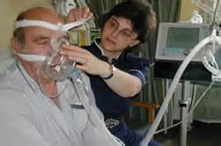
Acute Asthma Exacerbation/Status Asthmaticus
Treatment
If not responding or very severe
BiPAP:
Bilevel Positive Airway Pressure
External (non-invasive) positive pressure ventilation. Provides ventilatory support without intubation.
Only in pts who are awake, alert, cooperative.
Can do inline nebs with BiPAP

Slide 9
Acute Asthma Exacerbation/Status Asthmaticus
Treatment
Magnesium
2 gm IV
Smooth muscle relaxant/bronchodilator
Terbutaline
Sub-q or gtt
0.25 mg subq
Will cause tachycardia
Bronchodilator (beta-2 agonist); smooth muscle relaxant
Epinephrine
0.3 mg (1:1000) subq/IM
Bronchodilator
Caution in those with CAD/older pts

Slide 10
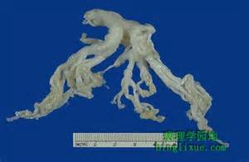
Status Asthmaticus
If still not responding to aggressive respiratory measures, meds
Intubate
Last resort!
Avoid breath stacking. Vent settings to allow for prolonged Exp phase
If pt loses pulses, ensure no pneumothorax, may need to perform B/L needle decompression of chest and place chest tubes
Lungs become so hyperinflated may have spontaneous ptx
Bronchial Cast (sputum) from status asthmatics pt

Slide 11
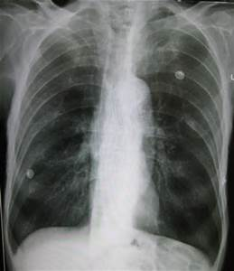
COPD
Emphysema and Chronic Bronchitis
May have components of both
Usually older individuals
Major problem is hypercarbia/CO2 retention due to decreased elastic recoil
Use your Hx & PE to guide workup
CXR
EKG
Labs including troponin
Most of these pts also have underlying cardiac dz, a COPD flare increases cardiac work and may cause an MI or CHF exacerbation
Hyperinflation
Decreased lung markings
Flattened diaphragms
May see blebs

Slide 12
COPD
Treatment:
Bronchodilators
Steroids
+/- Abx
Case by case. If infiltrate, definite abx. If no inflitrate, some physicians still prefer atypical coverage (avelox, zithromax)
BiPAP
Extremely useful in COPD. Can significantly improved pts ventilatory status.
Helps blow off CO2, improve hypercarbia
Can help prevent intubation of these pts!
Allows for lower FiO2 while providing non-invasive pressure support

Slide 13
COPD
Complications
VDRF
Even with optimal therapy, pts may still need intubation
Those who arrive with diminished mental status need early intubation to improve CO2 retention and hypercarbia
Apnea
These pts live at a higher CO2 than healthy individuals
Due to this, SpO2 is what stimulates their resp drive
Caution with FiO2, a NRB mask can make them apnic/hypopnic and quickly worsen the situation, further increase their CO2 retention cardiac arrest
Use lowest FiO2 possible for supplemental oxygen
Often ok with SpO2 >90% in these pts

Slide 14
Pneumonia
Can often diagnose clinically
Cough, fever, malaise
Elderly may just present with AMS
Aspiration pneumonia risks
h/o CVA (poor swallow), alcohol abuse, drug use, PEG tube
Diagnostics:
CXR (2 view optimal)
Infiltrate may not show initially, may “bloom” after hydration
Labs including Blood Cx’s if appears septic, anticipate ICU

Slide 15
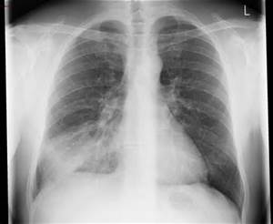
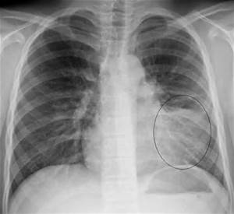
Pneumonia
Findings
Fever
Leukocytosis
Infiltrate on CXR
Again, CXR may lag behind, may diagnose a pneumonia clinically with focal rales/rhonchi and cough, fever

Slide 16
Pneumonia
Treatment
Outpt vs inpt tx
Outpt
Pt overall well appearing
No significant dyspnea, hypoxia
Can tol po intake
No AMS
Labs stable (no ARF)
Has appropriate f/u
Inpt tx
Typically elderly
Significant underlying lung dz
Cannot tol po intake
Septic appearing
Clinical impression
Clinical decision rules:
Pneumonia severity index
CURB 65

Slide 17
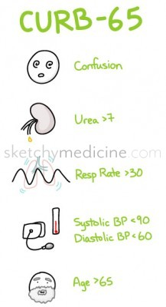
Pneumonia
from sketchymedicine.com
Confusion
Urea >7
Respiratory rate >30 breaths per minute
Blood pressure <90 systolic or <60 diastolic
65 years or older
Add up your points
■0 – 1 points: mild pneumonia (there’s only a 3% chance that your patient will go home and die, leaving you racked with guilt)
■2 points: moderate (9% risk of dying) – you should probably hospitalize this person
■3 – 5 points: severe (13-53% chance of dying) – you better admit this person, maybe even to the ICU

Slide 18
Pneumonia
Outpatient
Inpatient
Azithromycin (Zpak)
Doxycycline
100mg po BID
Co-morbidities (COPD, DM)
Levofloxacin (levaquin)
Moxifloxacin (avelox)
Augmentin + zpak
CAP (community acquired pneumonia) vs HCAP (healthcare associated pneumonia)
Dictates your Abx choice
Each hospital has pneumonia protocol

Slide 19
Pneumonia
CAP
HCAP
Ceftriaxone +
Azithromycin or doxy
Levofloxacin
Moxifloxacin
Pseudomonal coverage
Cefepime or zosyn +
Cipro or
Tobramycin
May add vanco for h/o MRSA, septic shock

Slide 20
Pneumonia
Complications
Septic shock
VDRF
Death

Slide 21
Congestive Heart Failure
Diastolic vs Systolic
Impaired relaxation vs impaired contractility
Typical presentation:
Dyspnea, orthopnea, LE edema
Sx’s may increase over days or sudden onset from uncontrolled HTN
Exam:
Tachypnea, rales, LE edema
Vitals
Often hypertensive in diastolic CHF
May be normotensive or hypotensive in systolic CHF

Slide 22
Congestive Heart Failure
Causes of Acute exacerbation
Medication noncompliance
Diet noncompliance
MI
Thyroid
Other systemic stress
Infection, trauma, GIB
COPD
etc

Slide 23
Congestive Heart Failure
Labs
CBC, BMP
Trop
BNP
ABG prn
EKG
CXR
Keep on monitor
Ensure IV access
Supplemental O2

Slide 24
Congestive Heart Failure

Slide 25
Congestive Heart Failure

Slide 26
CHF
Treatment
Preload reduction/vasodilation
Nitroglycerin (paste, drip)
Diuresis (if normotensive or hypertensive)
Lasix
Ionotropic support if needed
Dobutamine, dopamine
Respiratory support
BiPAP is very effective!
Intubation if needed

Slide 27
CHF
Complications
VDRF
Arrhythmia
Multisystem organ failure
Inadequate tissue perfusion
Cardiogenic shock
Death

Slide 28
Respiratory Failure
Who do we intubate?
Failure to ventilate
Not able to inhale enough O2, exhale enough CO2
Impending airway obstruction
Failure to oxygenate
Interruption of gas exchange
Inadequate mental status to protect airway
Easily/rapidly reversible? Bag till reversed
GCS <9, intubate. (“GCS of 8, Intubate!”)

Slide 29
Respiratory Failure
Etiology can vary greatly
Cardiac
Pulmonary
Shock states
CNS
Toxic/metabolic
Drug induced
Infectious
Trauma
Obstructive
And more!

Slide 30
Respiratory Failure
Remember in the EC, we always follow our ABCs!
Airway first
Ventilate/Intubate
Bag mask till you can intubate or reverse underlying cause
i.e. reverse hypoglycemia in a diabetic, give narcan in narcotic OD
Use RSI (rapid sequence intubation)
Drug choice based on patients presentation
Intubate with cuffed ETT (adults)
Direct visualization best
If difficult airway, may need glidescope, fiberoptic
Always try to anticipate complications
Know what your next step will be if your attempts fail
Don’t be a cowboy, call for backup if needed!
Surgery, anesthesia
Contraindications to intubation
DNR/DNI status
Certain facial, neck trauma indicate a surgical airway

Slide 31
Respiratory failure
Once airway is placed, confirm appropriate tube placement
Best indicator of appropriate tube placement?
Watching the tube pass through the cords
End tidal CO2
Auscultate over both lung fields, BS equal?
Auscultate over stomach
SpO2 appropriate for clinical situation?
CXR

Slide 32
Respiratory Failure
Now that your airway is secured, what next?
Treat underlying cause of VDRF, admit to ICU
Keep pt sedated
Again drug choice will be dictated by clinical scenario
Commonly used drugs:
Propofol: rapid on and off, can cause hypotension
Versed/ativan gtts: not as rapid off, hypotension
Fentanyl: usually in combo with another agent, short acting. Typically does not cause hyptension

Slide 33
Respiratory Failure
Common causes of Respiratory failure due to CNS disease
Intracranial Hemorrhage
Traumatic
Epidural, subdural, intra-parenchymal hematoma, SAH
Spontaneous
Aneurysm rupture
Hemorrhagic CVA
Large ischemic CVA with edema
Masses
Primary or metastatic lesions
All can lead to Mass effect herniation
Uncal herniation: ipsilateral nonreactive pupil “blown pupil”

Slide 34
Respiratory Failure
Drug induced
Narcotics and benzos most commonly
Alcohol frequently as well
Check pupils
Constricted in narcotic OD
Give Narcan IV/IM/via ETT
May require large doses
May require gtt if long acting drug
Benzos
Intubate
Rarely use flumazenil
Only use in benzo naive
Can precipitate intractable sz if used in those who are dependent
Classic case to use in accidental OD in child
More in Tox lecture

Slide 35
Airway Obstruction
Anticipate impending obstruction
Call backup as needed
Sx, anesthesia
If you have time, pt to OR for attempted intubation with anesthesia with sx standing by prepped for surgical airway

Slide 36
Airway Obstruction
Difficult airway examples
Angioedema
Epiglottitis
Retropharyngeal abscess
Midface trauma
Anatomic
Obese
Small jaw
Cervical arthritis/rigidity
Short neck

Slide 37
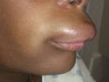
Airway Obstruction
Angioedema
Etiology
Allergic
ACE inhibitor
C1 esterase deficiency
“hereditary angioedema”
Undifferentiated

Slide 38
Angioedema
Treatment
ABCs-Airway!
How do you intubate a patient like this?
Optimally to OR for fiberoptic with sx standby if needed
Awake nasotracheal in ED
Anesthetize airway
Nebulize lidocaine
Hurricane spray
Supportive care
Avoidance/removal of offending agent
Epinephrine
Steroids
Benadryl
Time

Slide 39
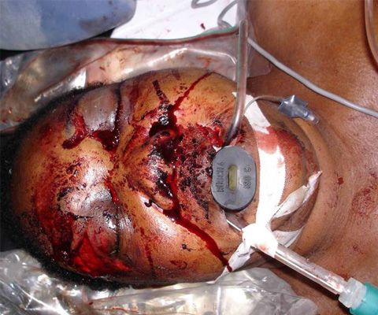
Traumatic Airway Obstruction
Caution with airway in pts with significant facial trauma
May have skull base disruption
Avoid nasotracheal intubation/NGTs
Careful orotracheal intubation or sx airway

Slide 40
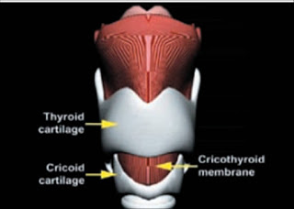
Surgical Airway
EM physicians trained to perform emergent cricothyroidotomy, a “cric”
If at a facility that you have sx and anesthesia, you should call for assistance when difficult airway anticipated
Sx/ENT can perform emergent tracheotomy as well.

Slide 41
Foreign body obstruction
Hx, exam will elicit complete vs partial
Incomplete obstruction presentation will vary based on size/type of object, location of fb
Upper airway (trachea)
Stridor
Lower airway (bronchus and beyond)
May show wheeze
Recurrent pneumonia may present with missed dx
Complete airway obstruction, pt will have no air exchange, unless acted upon rapidly cardiac arrest

Slide 42
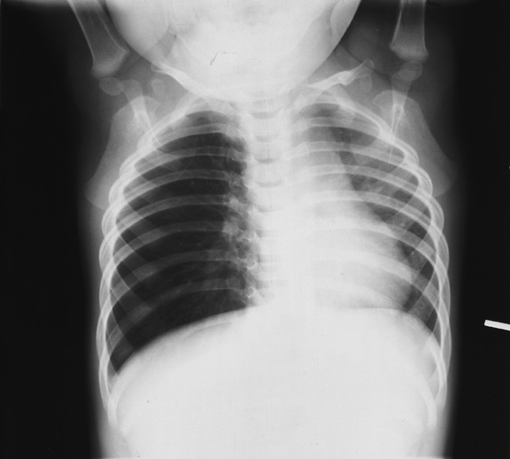
Foreign body aspiration
Incomplete obstruction:
CXR PA and lat if stable
Will show if radiopaque
Even if not radiopaque, may show signs of a fb
Hyperinflation
Infiltrate from post-obstructive pneumonia
Hyperinflation R lung with shift

Slide 43
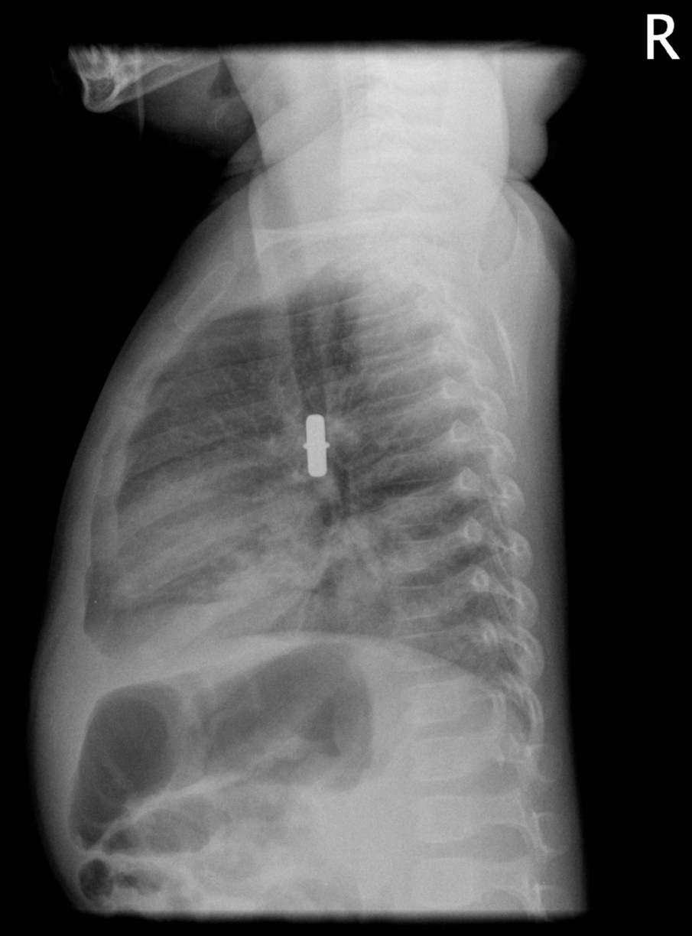
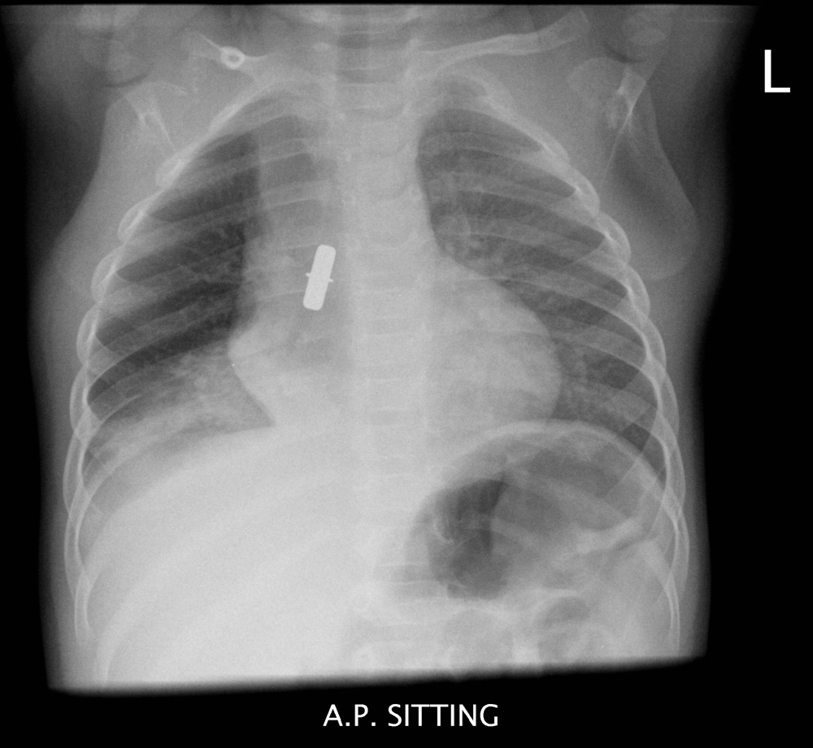
Foreign Body Aspiration

Slide 44
Foreign Body Aspiration
Treatment
Will need bronchoscopy for removal
If suspicious hx, exam, and CXR (-), still should have bronchoscopy to r/o radiolucent fb.

Slide 45
Foreign Body Aspiration
Complete Obstruction
BLS/ACLS protocol
Awake pt: Heimlich maneuver
Unconscious pt:
Out of hospital adult: abd thrusts
In EC:
Can attempt intubation
May be able to visualize and extract fb with forceps
If lodged in prox trachea, may be able to push distally with ETT to attempt to ventilate one lung
If prox obstruction you cannot relieve, surgical airway
Cric or emergent trach

Slide 46
The End
Take a breath!

